Slide 1
Generative Adversarial Network

Slide 2
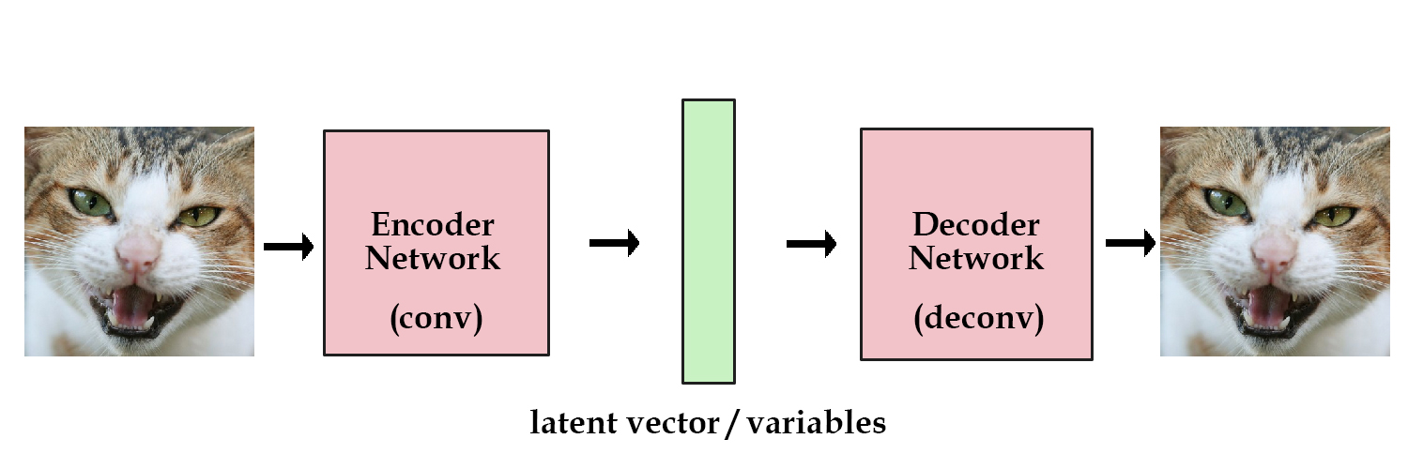
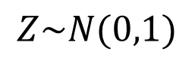
Generative Adversarial Network
Generator
Discriminator
Fake
Or
Real
$$Z\sim N(0,1)$$
Generate image as real as possible
Classify whether the image is fake or real
Loss function: give reward to generator if discriminator predicts it fake. Give reward to discriminator if it predicts generated image fake

Slide 3
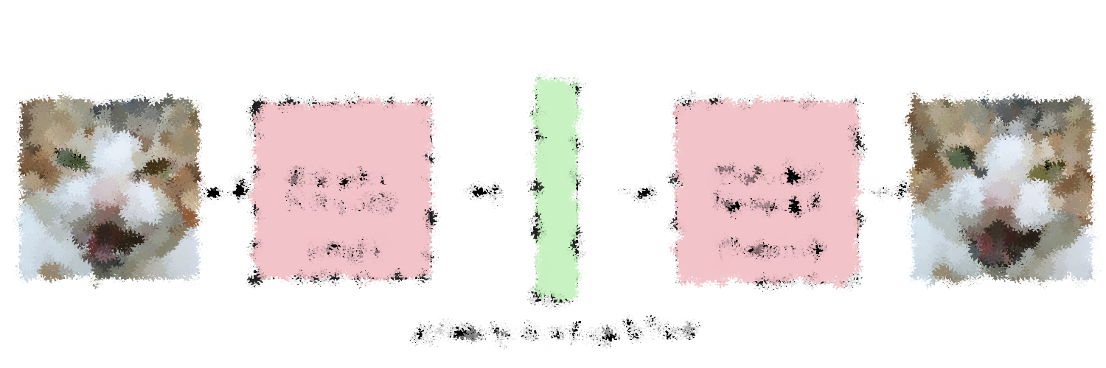
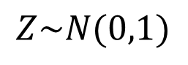
Generative Adversarial Network
Generator
Discriminator
$$Z\sim N(0,1)$$
Fake data
Fake
Or
Real
The generator and discriminator “fight” each other.
The generator keeps learning to fool the discriminator
Discriminator keeps learning to detect fake images
Real data

Slide 4
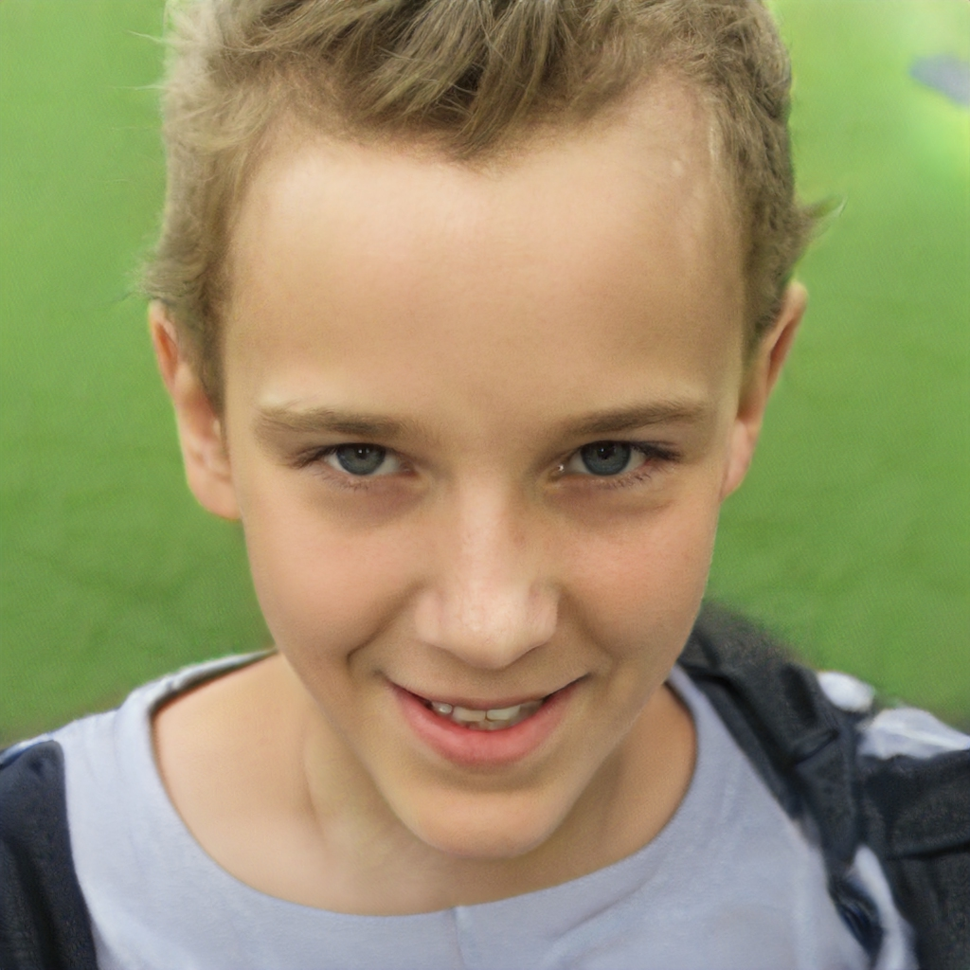
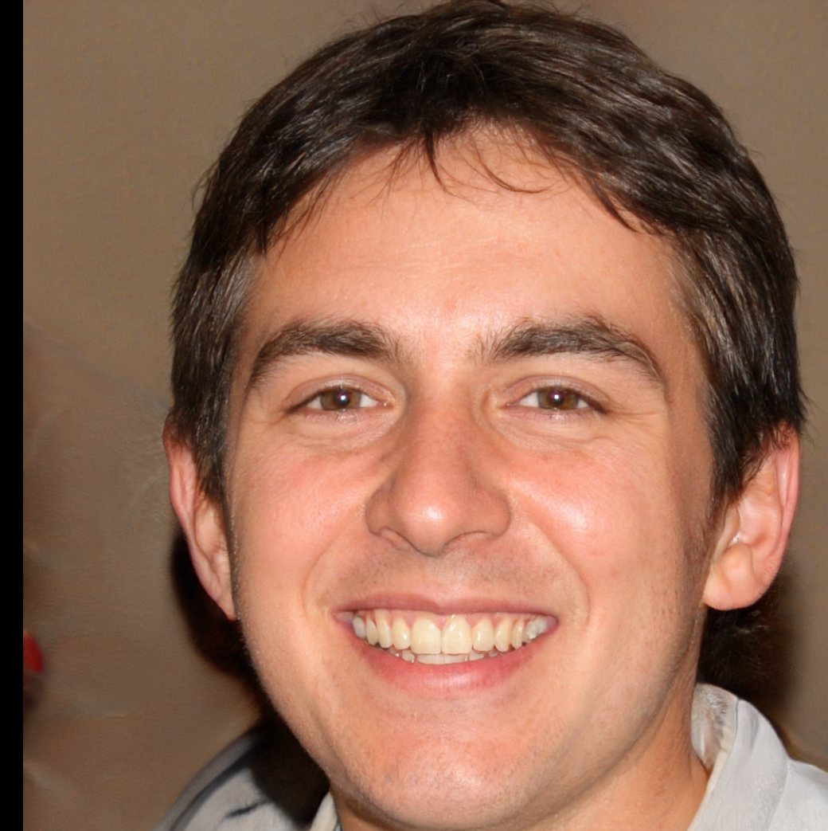
https://thispersondoesnotexist.com/

Slide 5
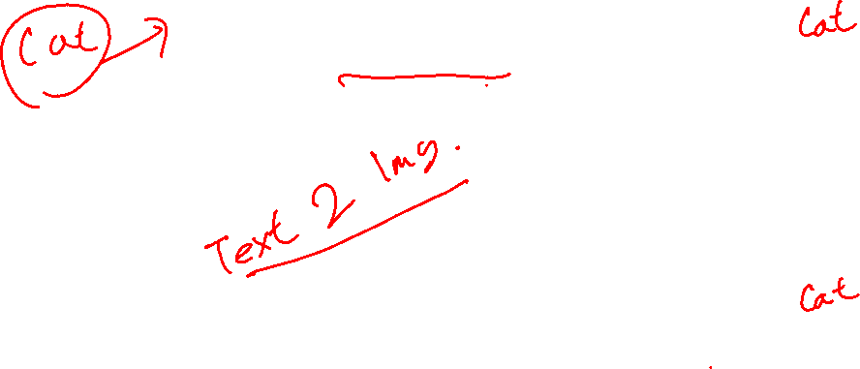
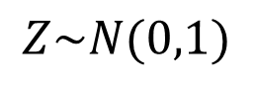
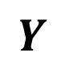
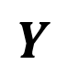
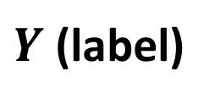
Conditional GAN
Generator
Discriminator
$$Z\sim N(0,1)$$
Fake data
Fake
Or
Real
$Y$ (label)
$$Y$$
Real data
$$Y$$

Slide 6
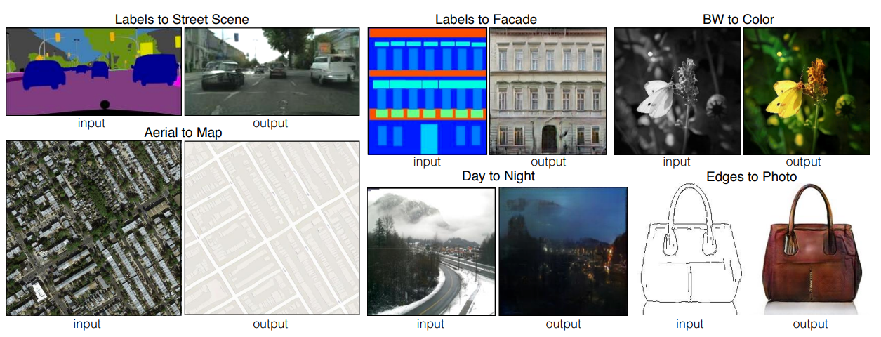
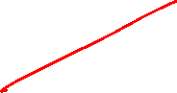
Conditional GAN
Image-to-image translation: Pix2Pix Gan
https://arxiv.org/abs/1611.07004

Slide 7
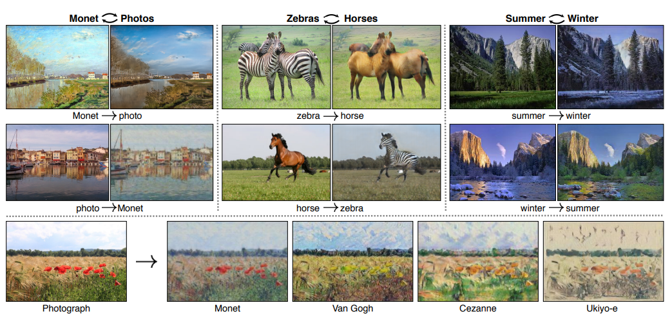
Conditional GAN
CycleGan
https://arxiv.org/abs/1703.10593

Slide 8
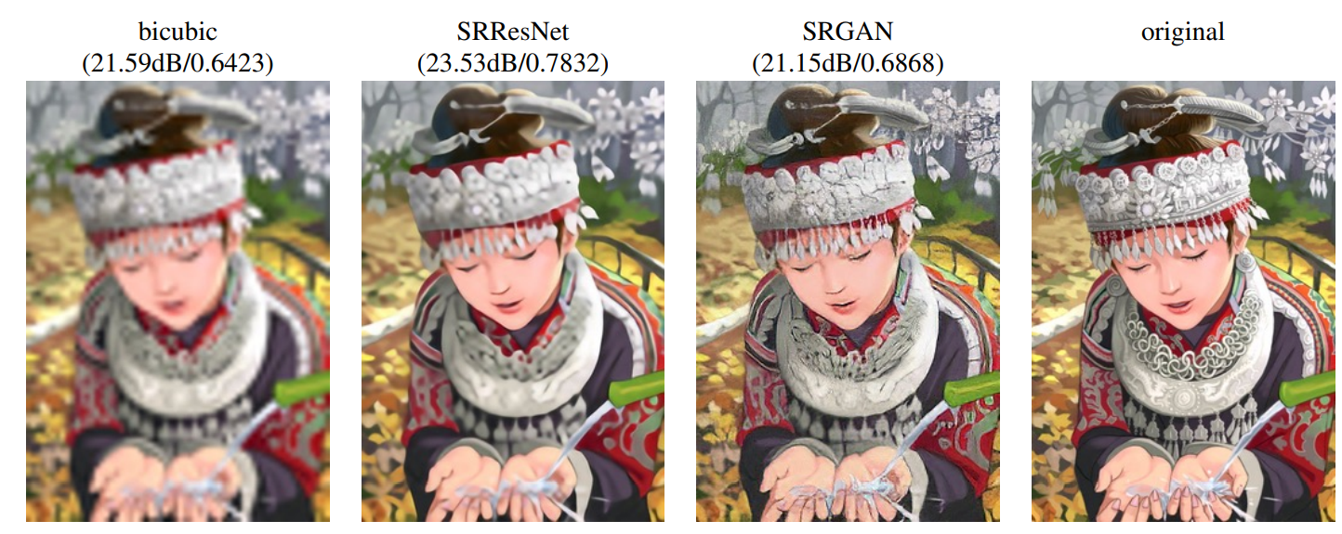
Conditional GAN
Super-resolution
https://arxiv.org/abs/1609.04802

Slide 9
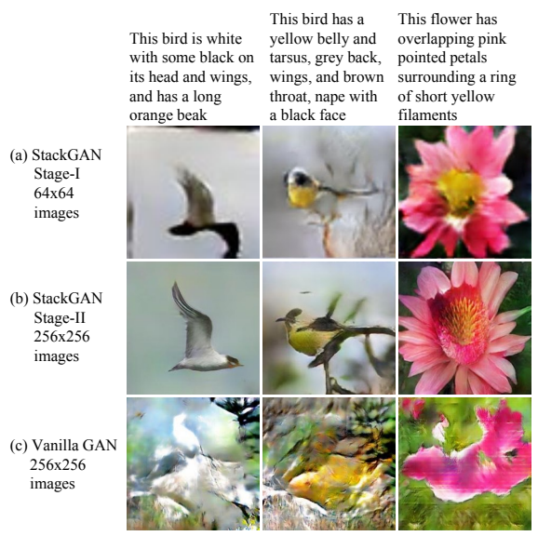
Conditional GAN
Text-to-image Synthesis
https://arxiv.org/abs/1612.03242

Slide 10
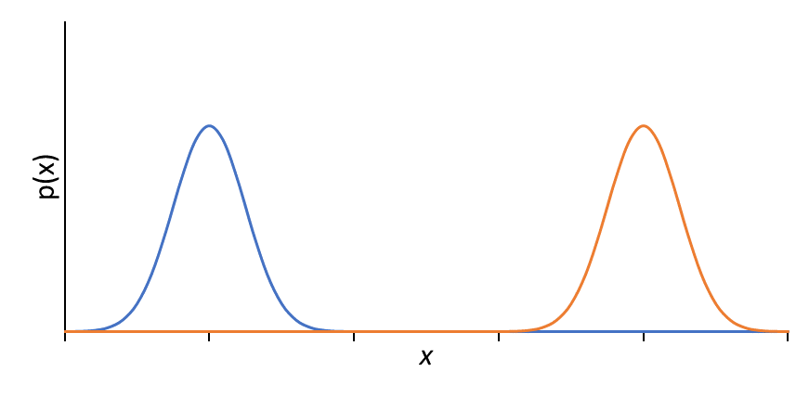
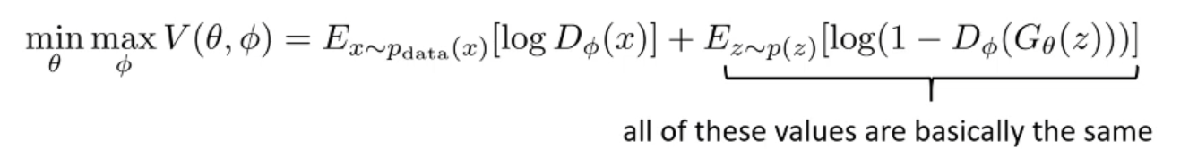
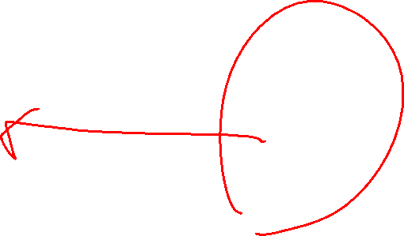
Training GAN is hard
D(x)
Real data
Generated data
No distinction in loss value between generated data
Distance between real and generated data unaccounted

Slide 11
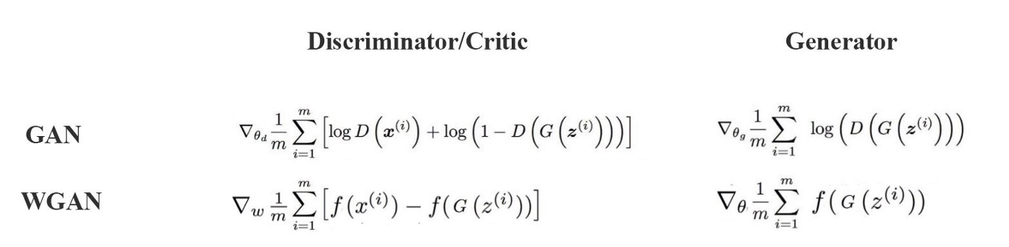
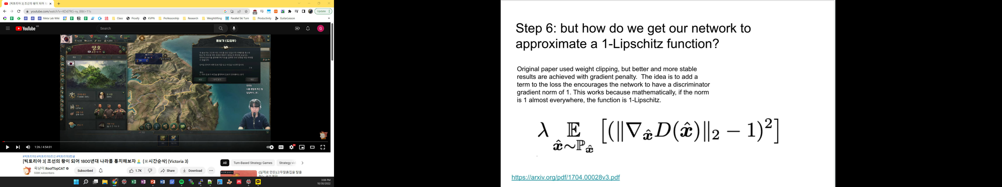
Earth Mover’s Distance (Wasserstein Distance)
Minimum cost of transporting mass to make two distribution similar
Real data
Generated data
Gradient Penalty for WGAN
https://arxiv.org/abs/1701.07875

Slide 12
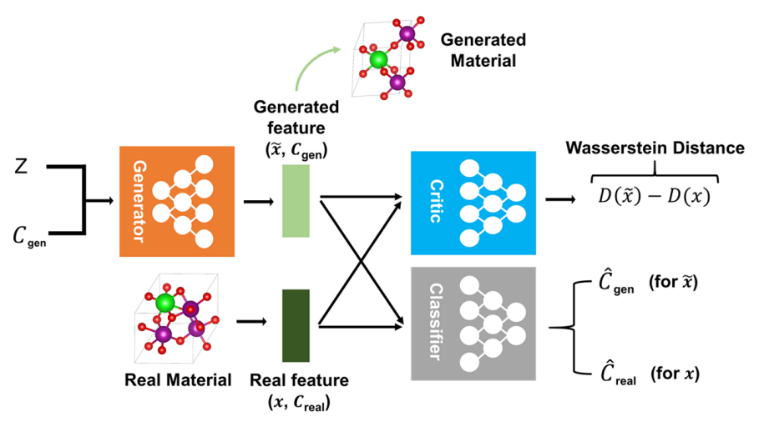
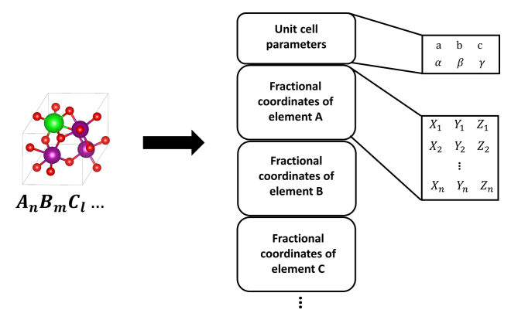
Generating Crystal Structure
ACS Cent. Sci. 2020, 6, 1412−1420

Slide 13
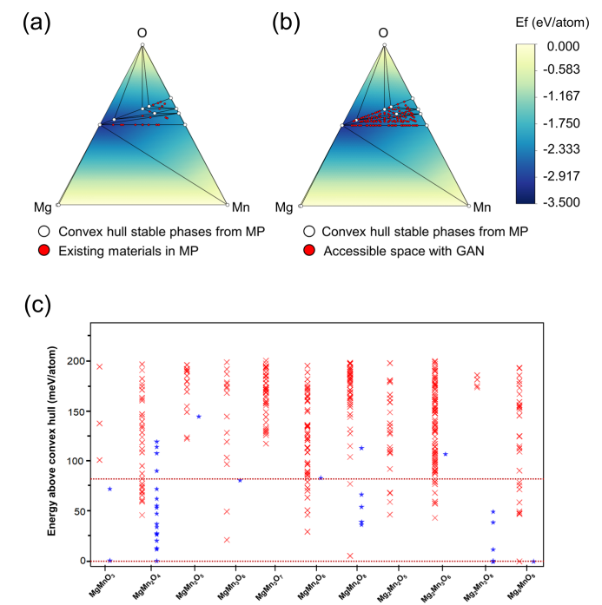
Generating Crystal Structure
ACS Cent. Sci. 2020, 6, 1412−1420

Slide 14
Coding
class Generator(torch.nn.Module):
def __init__(self):
super().__init__()
self.main_module = nn.Sequential(
nn.Linear(128,128),
nn.SELU(),
nn.Linear(128,118))
def forward(self, x):
return self.main_module(x)
class Discriminator(torch.nn.Module):
def __init__(self):
super().__init__()
self.main_module = nn.Sequential(
nn.Linear(118,128),
nn.SELU(),
nn.Linear(128,1))
def forward(self, x):
return self.main_module(x)

Slide 15
Coding
### 1. training discriminator
z = torch.randn(xr.shape[0], 128)
z = z.to(device=device)
xr = xr.to(device=device)
xf = G(z).detach()
Dreal_loss = D(xr).mean()
Dfake_loss = D(xf).mean()
gp = calculate_gradient_penalty(D, xr, xf.detach())
D_loss = - Dreal_loss + Dfake_loss + 10 * gp
Doptimizer.zero_grad()
D_loss.backward()
Doptimizer.step()
### 2. training generator
z = torch.randn(xr.shape[0], 128).to(device=device)
xf = G(z)
G_loss = - D(xf).mean()
Goptimizer.zero_grad()
G_loss.backward()
Goptimizer.step()

Slide 16
Coding
def calculate_gradient_penalty(D, xr, xf):
eta = torch.rand(xr.shape[0],1).to(device=device)
interpolated = eta * xr + (1 - eta) * xf
interpolated.requires_grad_()
prob_interpolated = D(interpolated)
gradients = autograd.grad(outputs=prob_interpolated, inputs= interpolated, grad_outputs= torch.ones_like(prob_interpolated).to(device=device), create_graph=True, retain_graph=True, only_inputs=True)[0]
grad_penalty = ((gradients.norm(2, dim=1) - 1) ** 2).mean()
return grad_penalty
Gradient Penalty for WGAN

